Slide 1
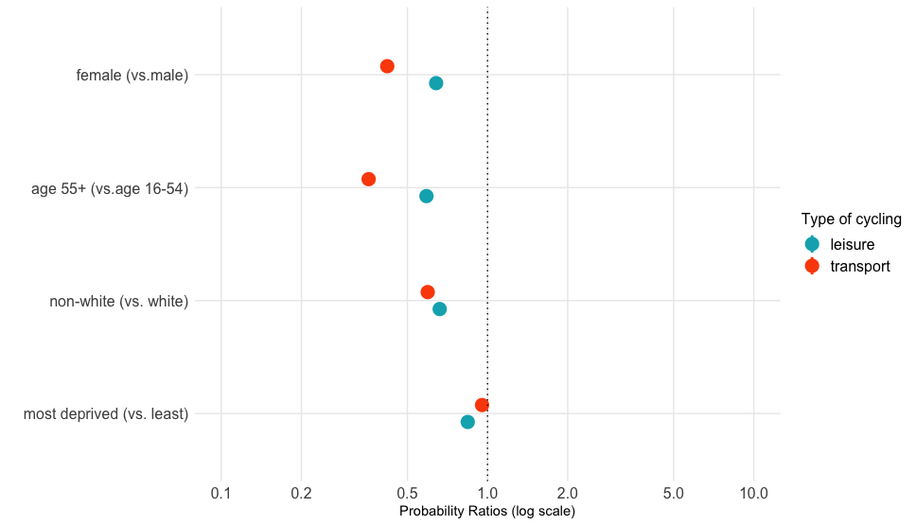
Less likely
Females are 0.4 as likely as males to cycle for transport

